Slide 1

Project :- GROW IT YOURSELF Under the guidance of Prof.Mallikarjun G. Ganachari Submitted By:- 1. Miss. Gayatri M. Jangam USN:-2VS16EC011 2.Miss. Asiya A. Desai USN:-2VS17EC400 3.Miss. Priyanka S. Tibile USN:-2VS17EC404 4. Miss. Trupti C. Patil USN:-2VS17EC408
Vidya Samvardhak Mandal’s VSM’s SOMASHEKHAR R. KOTHIWALE INSTITUTE OF TECHNOLOGY, NIPANI Academic Year 2019-20

Slide 2
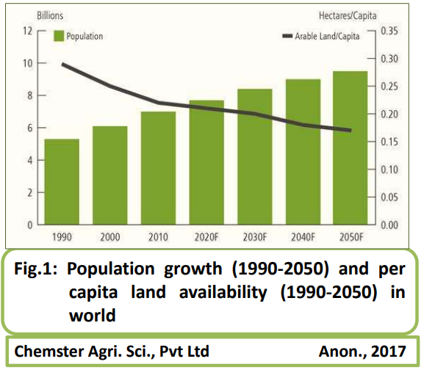

Slide 3
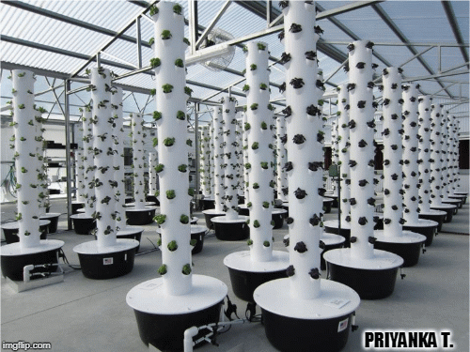
GROW IT YOURSELF

Slide 4
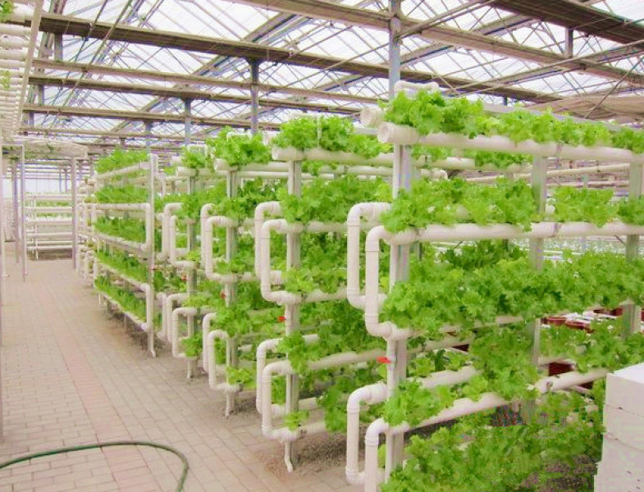
CONTENTS
Introduction
Methodology
Block Diagram
Advantages
Disadvantages
Applications
Conclusion
References

Slide 5
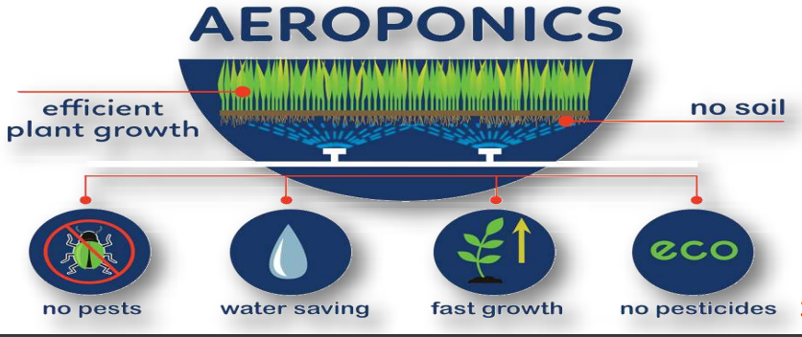
INTRODUCTION
Aeroponics is the process of growing plants in an air or mist environment without the use of soil or an aggregate medium. The word "aeroponics" is derived from the Greek meanings of aer (ἀήρ, "air") and ponos (πόνος, "labour").
It is the practice of growing plants without soil, with roots in a misty environment

Slide 6

HISTORY
Hydroponic gardening has its roots in ancient history. 600 B.C., gardeners at the Hanging Gardens of Babylon–Earlier one of the seven wonders of the world–may have employed hydroponic principle

Slide 7
AEROPONICS HISTORY
1942 - W. Carter first researched air culture growing and described a method of growing plants in water vapour
1957 - Went, first coined the air-growing process as “aeroponics” and also attempted in Tomato & Coffee
1983 - The first commercially available aeroponic apparatus was manufactured and marketed by GTi. It was known as “Genesis Machine” & it is marketed as “Genesis rooting system”
1985 - Stoner's company (GTi) was the first company to manufacture, market and apply large-scale closed-loop aeroponic systems into greenhouses for commercial crop production
2006 - The Agriculture University of Hanoi, Vietnam started the postgraduate doctoral program in aeroponics

Slide 8
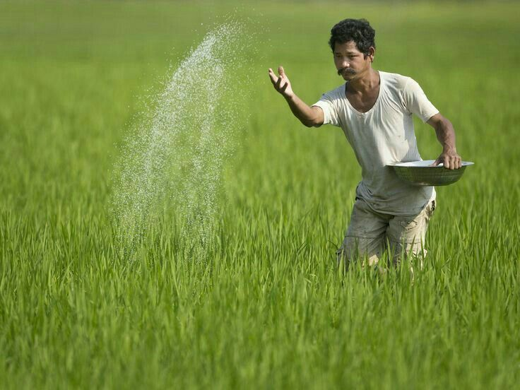

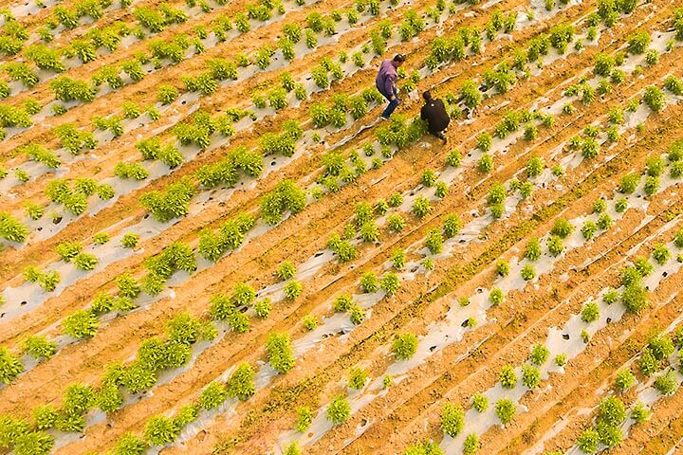
METHODOLOGY
TRADITIONAL METHOD

Slide 9
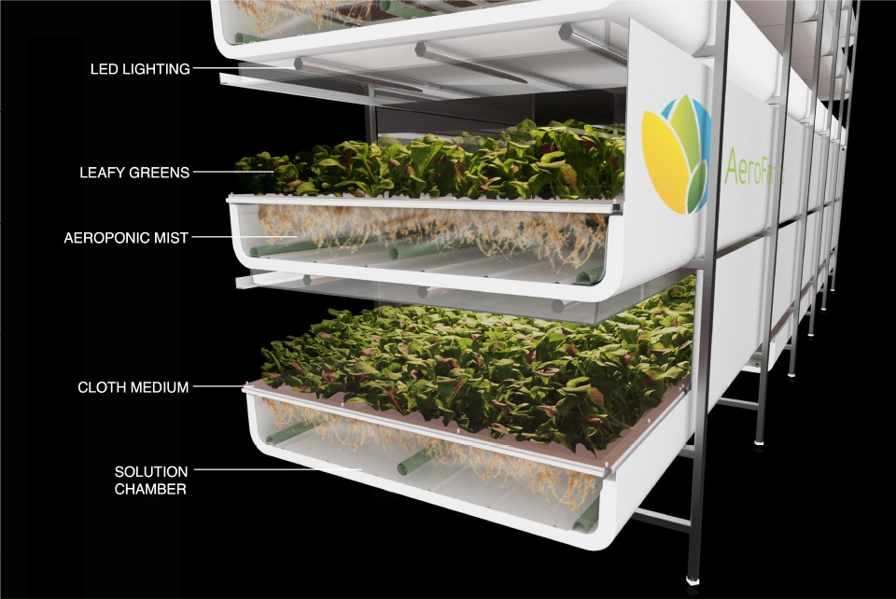
AEROPONICS METHOD

Slide 10
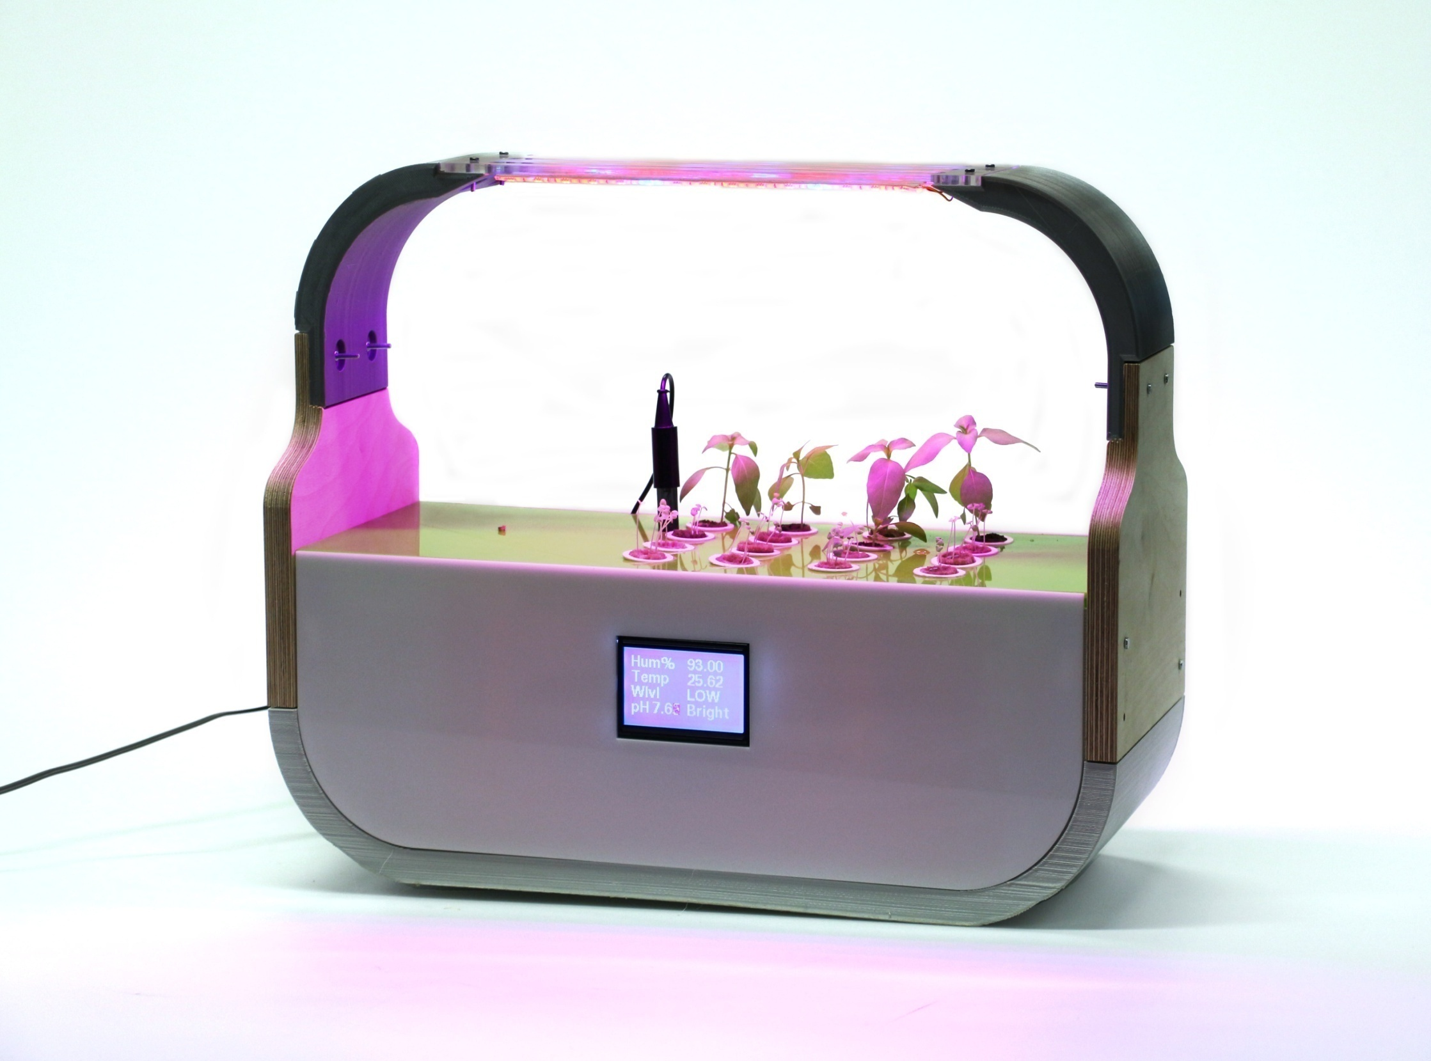

Slide 11
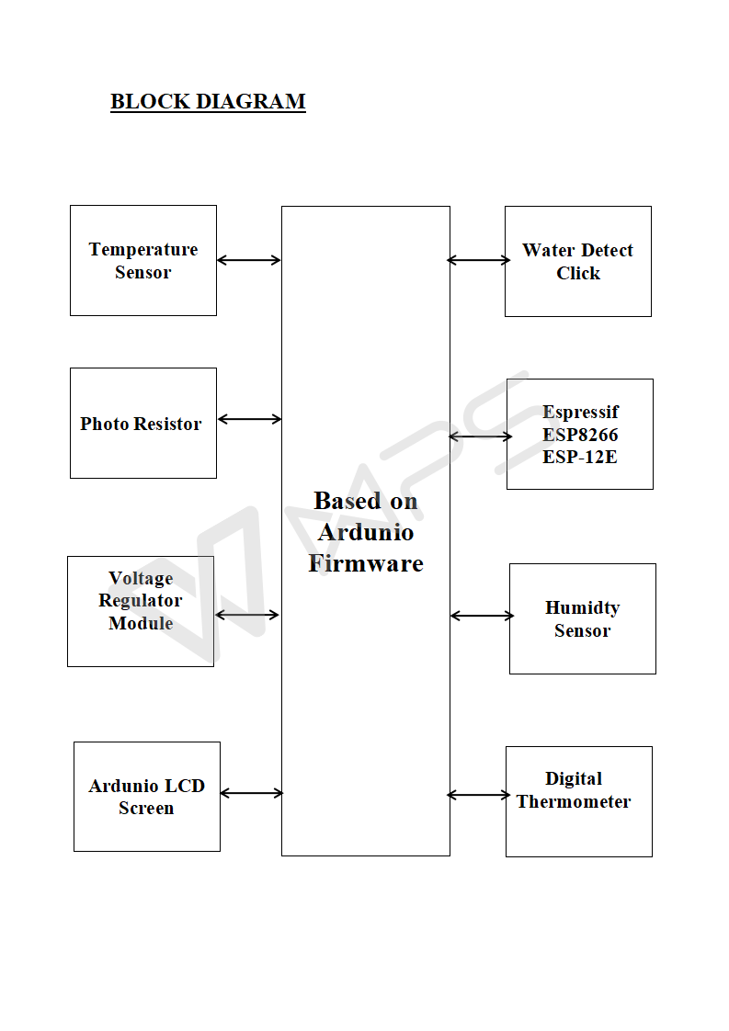

Slide 12
HARDWARE & SOFTWARE USED
HARDWARE’S USED
pH sensor
Ardunio Mega 2560
UV Sensor
Temperature sensor
Light intensity sensor
UV and normal leds
Relay
Ultrasonic sensor
2.4 inch touch display
DHT11 Humidity sensor
Power supply
Necessary tools & machines
3D-printer(generic)
Laser cutter(generic)
SOFTWARE’S used
Arduino IDE
Serial Monitor

Slide 13
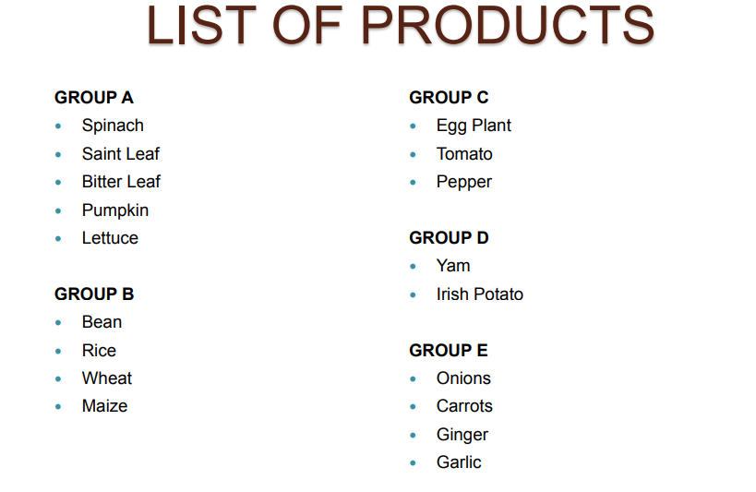

Slide 14
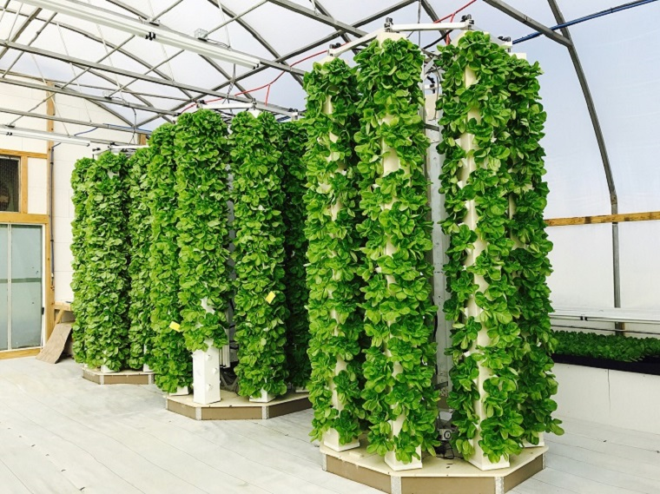
ADVANTAGES
No Soil
Easy to automatize
Controlled environment
Shorter crow cycles
Vertical farming possible
Less water
Indoor
Air quality enhancement

Slide 15
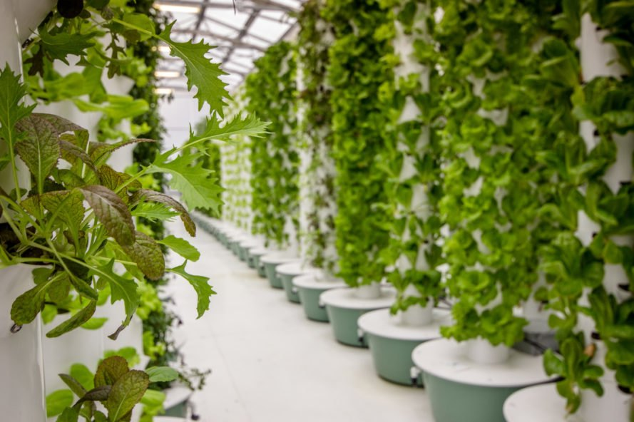
DISADVANTAGES
Power Dependency in Aeroponics System
Initial setup for Aeroponics System
Technical Knowledge

Slide 16
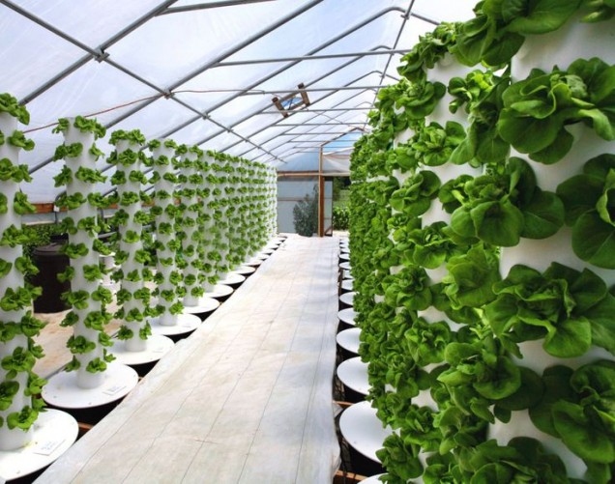
APPLICATIONS
Retail /hotel/fast food Chains
NASA
Private Investors
Public Sector Companies
Ex. Railway Catering companies(IRCTC)
Processed Food Industry
Corporate Hospitals
FFV Exporters
Large land owners
NGO’s
Foreign Retail Companies

Slide 17
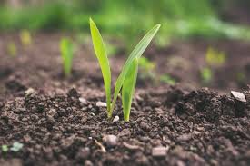
CONCLUSION
The Commercial Aeroponics industry is a successful industry and is rapidly expanding.
The market is larger than opined as produce is sold on quality rather than production method.
Aeroponics cannot displace bulk commodity items.
The industry is expected to grow exponentially as conditions of soil growing is becoming difficult.
Government intervention and university interest can propel the use of this technology.

Slide 18
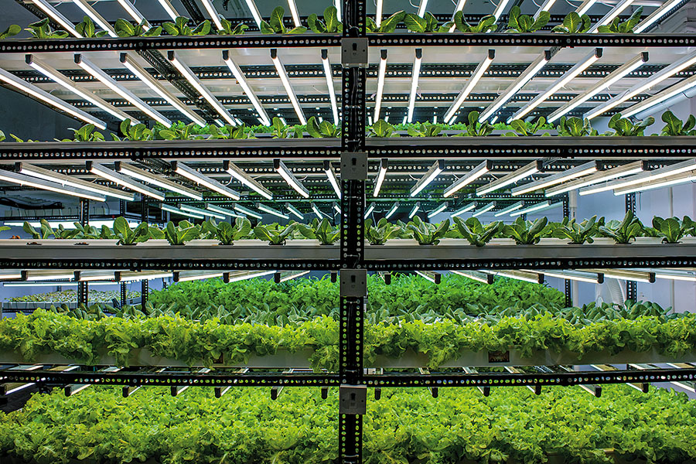
REFERENECES
G. Sandhi et al. “Visually Guided Operation in Green-House”, Intelligent Robots and Systems '90. 'Towards a New Frontier of Applications', Proceedings. IROS '90. IEEE International Workshop on, July 1990.
K. Rangan et al. “An Embedded Systems Approach to Monitor Green-House”, Recent Advances in Space Technology Services and Climate Change (RSTSCC), 2010.
Wei Ai et al., “Green House Environment Monitor Technology Implementation Based on Android Mobile Platform”, Artificial Intelligence, Management Science and Electronic Commerce (AIMSEC), 2011 2nd Conference on, August 2011.
C. Akshay et al., “Wireless Sensing and Control for Precision Green House Management”, Sensing Technology (ICST), 2012 Sixth International Conference, December 2010.
AjiHanggoro et al., “Green House Controlling and Monitoring Using Android Mobile Application”, QiR (Quality in Research), 2013 International Conference, June 2013.
Thenmozhiet al., “Green House Management Using Embedded System and ZigBee Technology”, International Journal of Advanced Research in Electrical, Electronics and Instrumentation Engineering, February 2014.

Slide 19

THANK YOU.

Slide 20

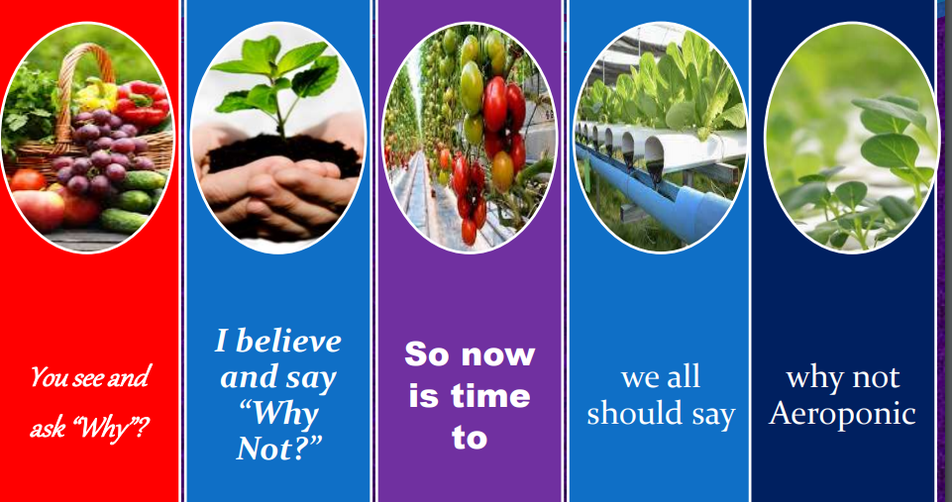
ANY QUESTIONS?

